Slide 1
Converting Flask Application to Exe

Slide 2

Folder Structure (.py file)
env
Make sure folder structure is as shown here
Project Folder
templates
static
css
img

Slide 3
Converting Flask app to exe process
Make sure flask application is working
Make sure the virtual environment is activated
Create a webview
Convert webview to .exe using pyinstaller

Slide 4
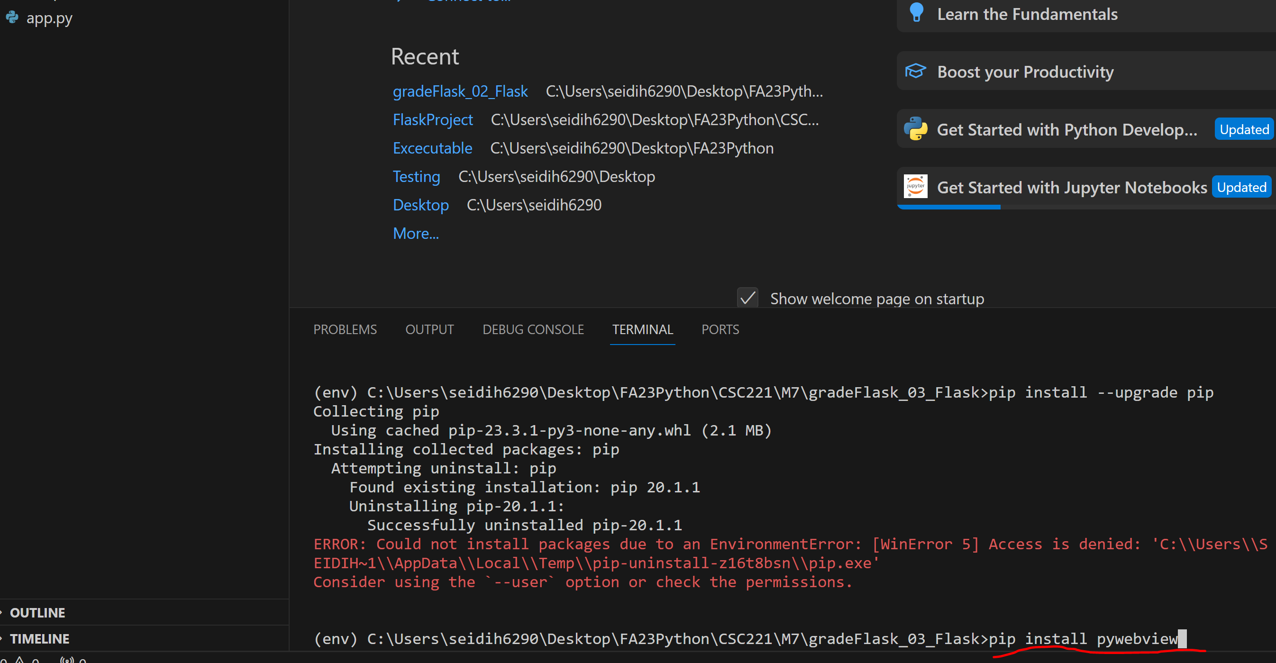
Step 1 pip install pyWebview
Install pywebview in virtual environment pip install pywebview

Slide 5
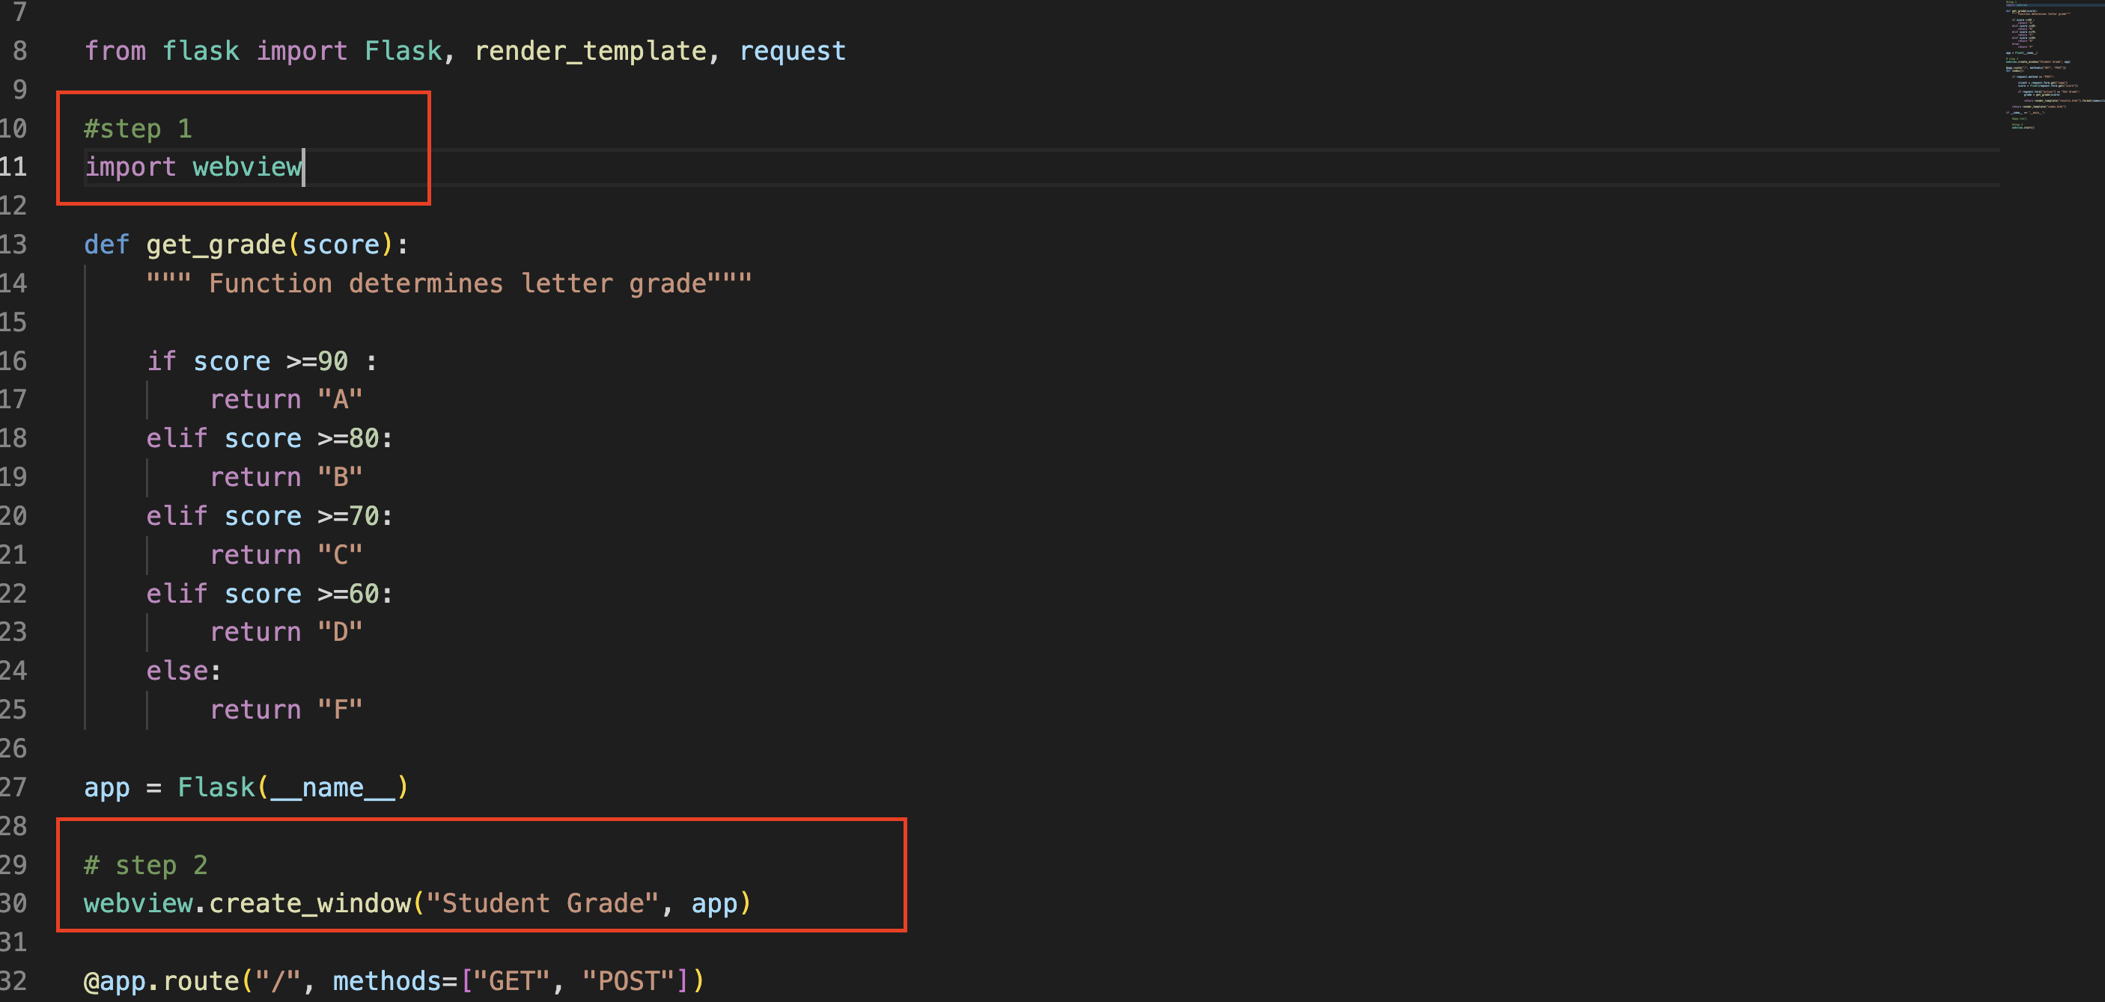
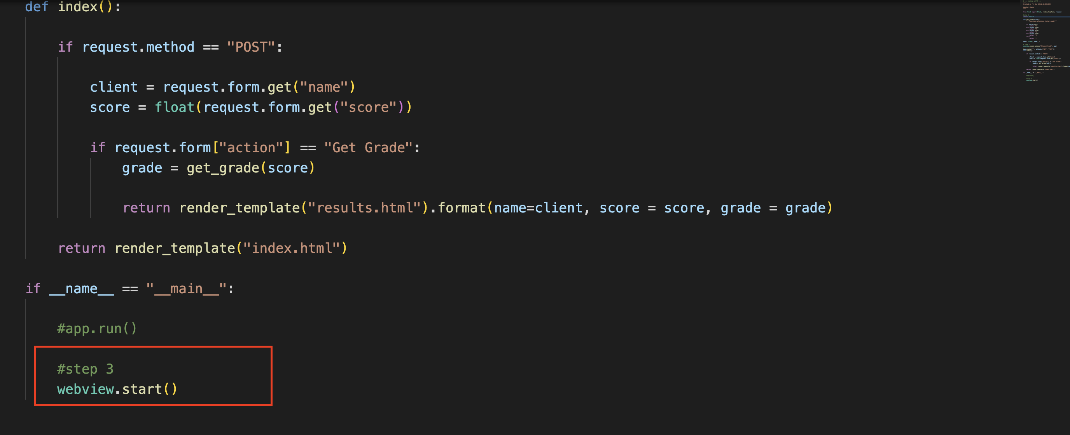
Step 2 import webview to main .py file
Add three important statement to main .py file
Import webview
Create a webview window
Start the webview window that was created.

Slide 6
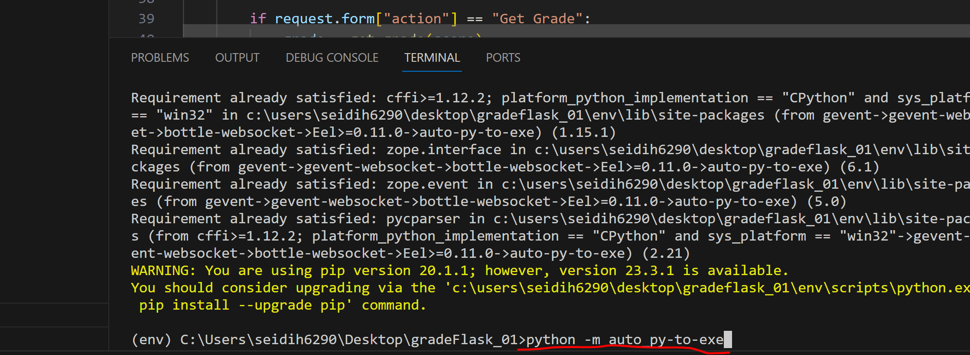
Step 3 convert to .exe using pyinstaller
Important :The process is straight forward when implemented on Windows , it’s not the case on a Mac.
Creating .exe for webview app on Windows
Make sure the virtual environment is active
Run pip install auto-py-to-exe in the command line (this a GUI that will facilitate the process )
Run auto-py-to-exe or python -m auto_py_to_exe to launch the GUI.
Continued next slide

Slide 7
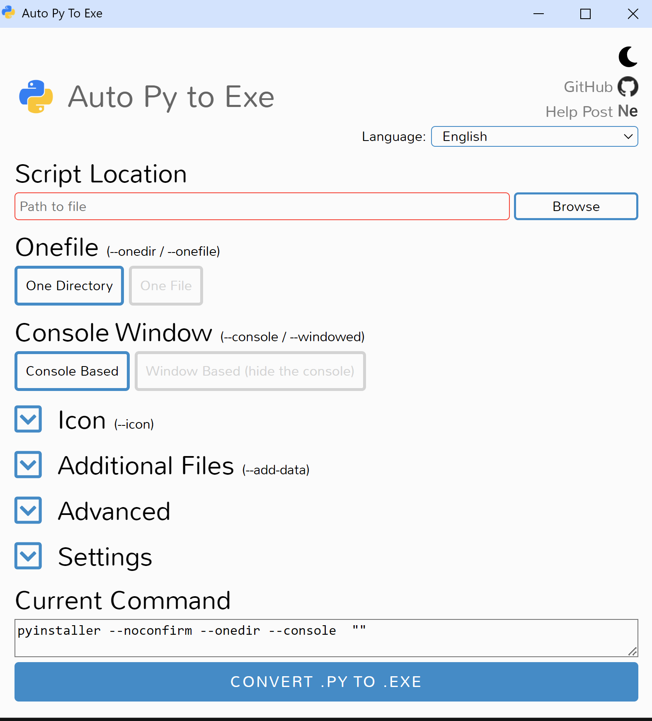
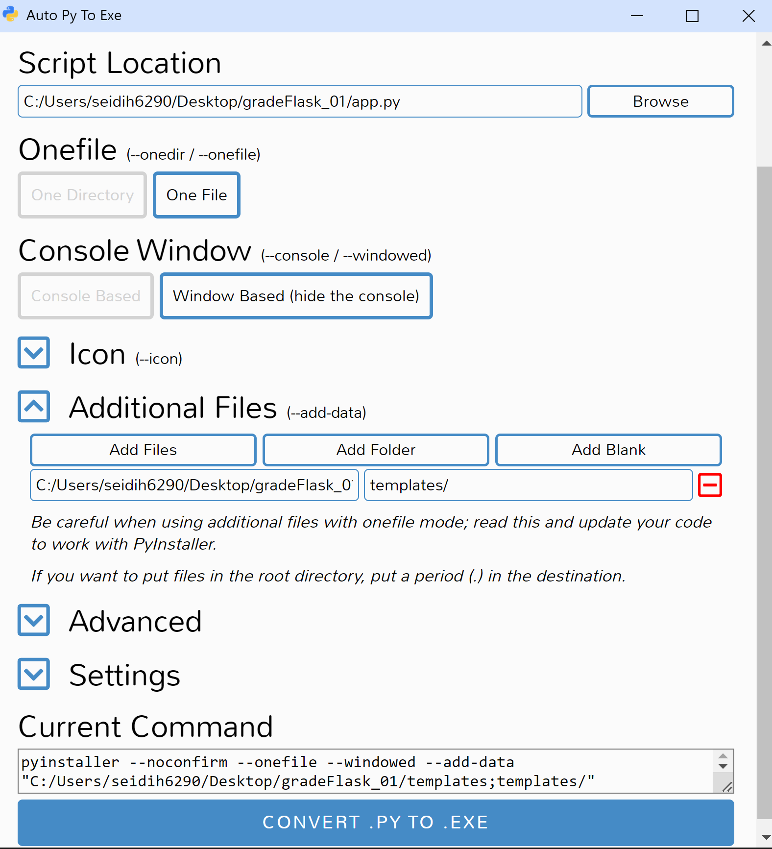
Step 3 convert to .exe using pyinstaller
Creating .exe for webview app on Windows
Step 4. After running command shown in step 3 in the previous slide, a GUI similar to the one shown here will appear
Application file here
Choose “One File”
Choose “One File”
Choose “Window Based”
Select “Add Folder” then choose the templates folder
Notice path to “templates” folder appears here
Click this button

Slide 8
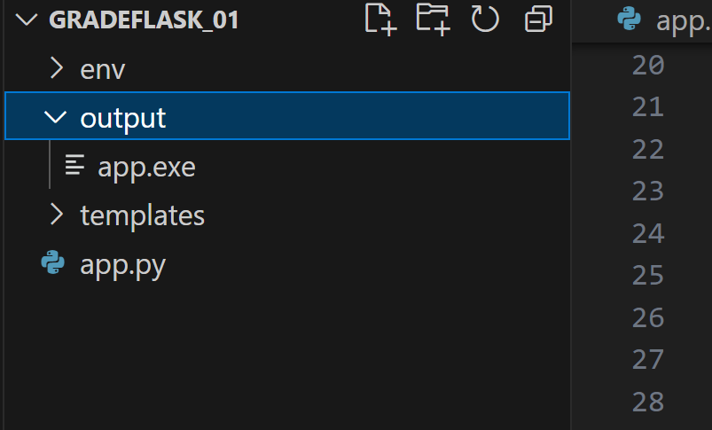
Step 3 convert to .exe using pyinstaller
Creating .exe for webview app on Windows
After completing steps shown in previous slide, a .exe file will be created and placed in a folder named “output”

Slide 9
Step 3 convert to .exe using pyinstaller
Important :The process is straight forward when implemented on Windows , it’s not the case on a Mac.
Creating .exe for webview app on a mac
Pyinstaller should be installed
Pip install greenlet==1.1.3 gevent==21.12.0
Then run command shown below
pyinstaller –onefile –add-data “templates:templates” –windowed app.py
The steps above will generate an executable only not stand alone!

Slide 10
Solution for .exe problem on a mac
We create the application , convert it to webview app in our Mac lab(if you’ll be using those computers).
We then use a Windows computer to convert it to an exe. To get it to work right with no issues with changes in virtual environment, we will do the following
Open the project in VS Code
Delete the virtual environment we created and create another one(why? Well because we can’t activate a virtual environment that was created on a Mac in Windows (even if bin is changed to scripts)
Pip install flask, pywebview to get the webview app to work
Test the program and make sure the webview app is working
Pip install auto-py-to-exe and generate the exe file

